Slide 1
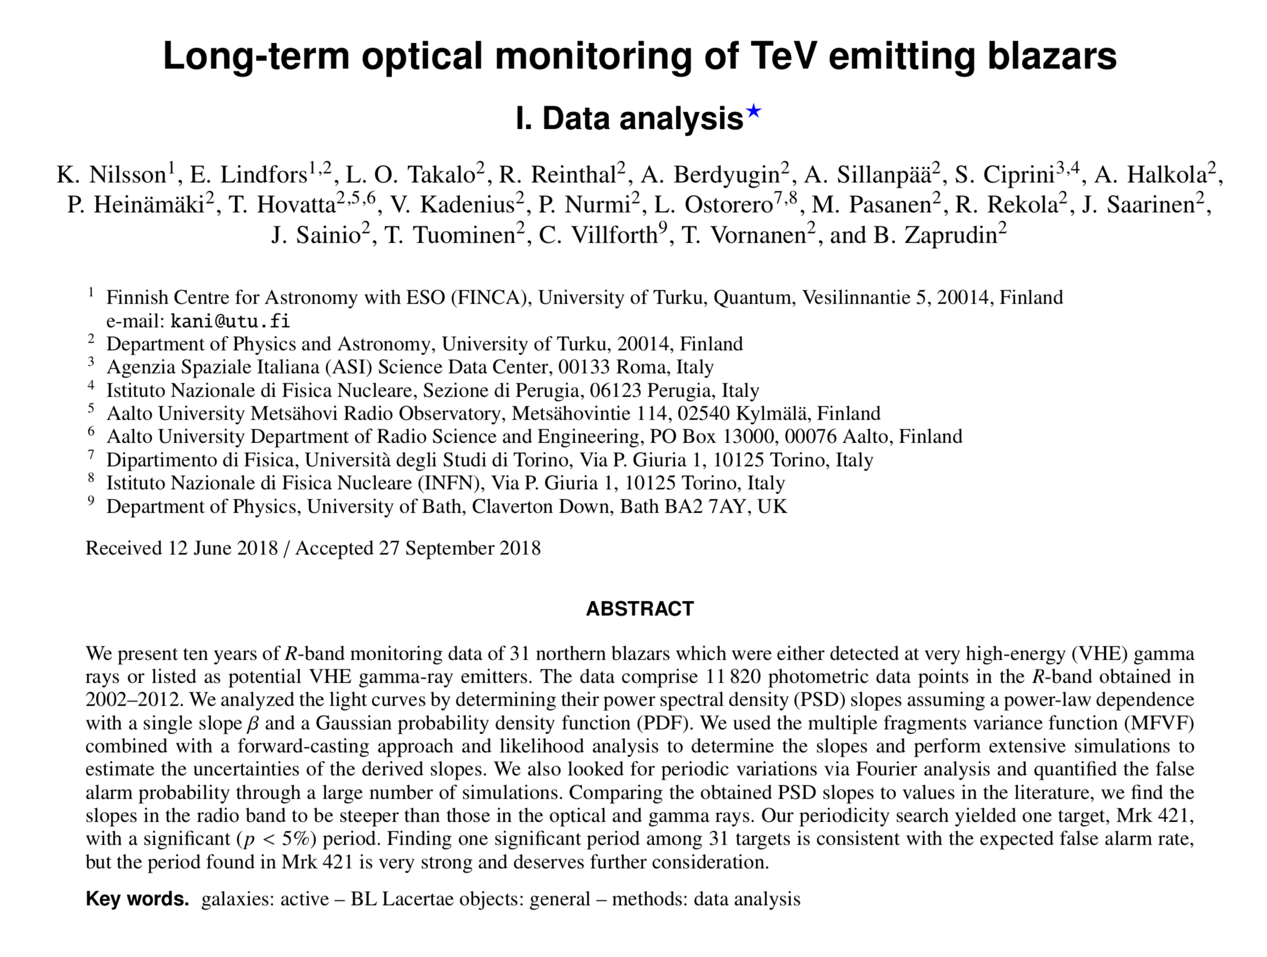
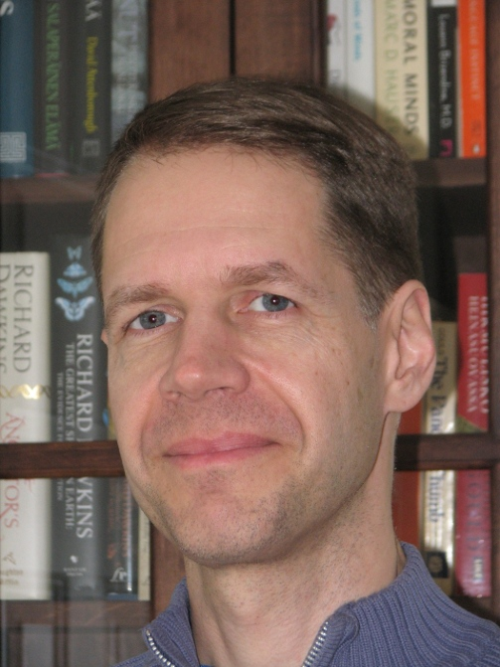
HOMEWORK 4
Optical Monitoring of Blazars
Kari Nilsson

